Slide 1
Proprotion
J. Wilson

Slide 2
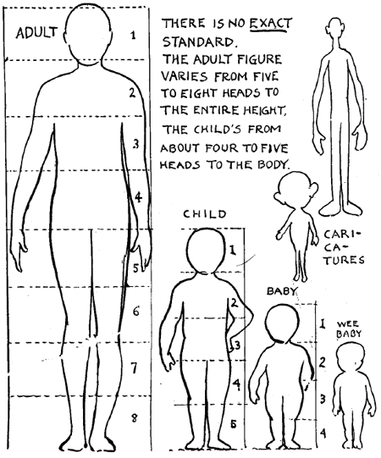
When drawing people, we can use proportion to help us get the shape right. The rule of thumb is an adult is eight heads high, a child is 5 heads high and a baby is 4 heads high.
Michelle has draw three figures;
figure 1 has a head of 3cm and a body of 24cm.
figure 2 has a head of 5cm and a body of 20cm.
figure 3 has a head of 4cm and a body of 20cm.
Which is the child, which is the adult and which is the baby?

Slide 3
Topic : Proportion
24
7
30
Date
EQ : How do we know if 2 ratios are in proportion?
What is proportion?
When 2 ratios simplify to give the same ratio, they are said to be in proportion.
Eg 80km every 2h is proportionate to 240km every 6h
80:2 = 240:6
40:1 = 40:1
What is the easy way to check for proportionality?
1. First check the ratios are using the same units.
4 kg costs $2 and 6000g costs $3 - 6000g is 6kg so …
These ratios become 4kg:$2 and 6kg:$3
2. Divide the left side by the right side
4kg:$2 becomes 4÷2 = 2 6kg:$3 becomes 6÷3 = 2
3. If they both equal the same amount they are proportional.
These can both be simplified to 40:1. They are equivalent to each other
How can we find out if they are in proportion?

Slide 4
What does a graph of a proportional relationship look like?

Slide 5
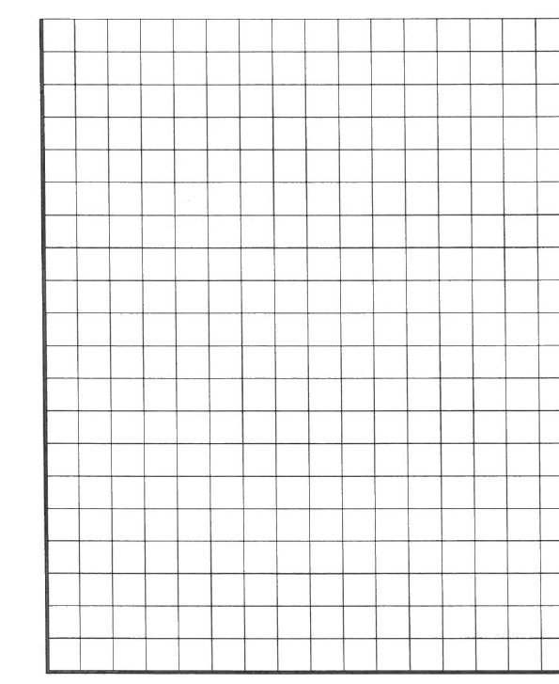
What does a graph of a proportional relationship look like?
$:Kg | $÷kg
4:2
8:4
10:5
$:Kg | $÷kg
6:2
10:4
12:5
$:Kg | $÷kg
2:2
8:4
15:5
$
18
17
16
15
14
13
12
11
10
9
8
7
6
5
4
3
2
1
0
$
18
17
16
15
14
13
12
11
10
9
8
7
6
5
4
3
2
1
0
$
18
17
16
15
14
13
12
11
10
9
8
7
6
5
4
3
2
1
0
1 2 3 4 5 6 Kg
1 2 3 4 5 6 Kg
1 2 3 4 5 6 Kg

Slide 6
What does a graph of a proportional relationship look like?
$:Kg | $÷kg
4:2 | 2
8:4 | 2
10:5 | 2
$:Kg | $÷kg
6:2
10:4
12:5
$:Kg | $÷kg
2:2
8:4
15:5
Proportional as $÷Kg gives the same answer each time
$
18
17
16
15
14
13
12
11
10
9
8
7
6
5
4
3
2
1
0
$
18
17
16
15
14
13
12
11
10
9
8
7
6
5
4
3
2
1
0
$
18
17
16
15
14
13
12
11
10
9
8
7
6
5
4
3
2
1
0
1 2 3 4 5 6 Kg
1 2 3 4 5 6 Kg
1 2 3 4 5 6 Kg

Slide 7
What does a graph of a proportional relationship look like?
$:Kg | $÷kg
4:2 | 2
8:4 | 2
10:5 | 2
$:Kg | $÷kg
6:2 | 3
10:4 | 2.5
12:5 | 2.4
$:Kg | $÷kg
2:2
8:4
15:5
Proportional as $÷Kg gives the same answer each time
Not Proportional as $÷Kg does not give the same answer each time
$
18
17
16
15
14
13
12
11
10
9
8
7
6
5
4
3
2
1
0
$
18
17
16
15
14
13
12
11
10
9
8
7
6
5
4
3
2
1
0
$
18
17
16
15
14
13
12
11
10
9
8
7
6
5
4
3
2
1
0
1 2 3 4 5 6 Kg
1 2 3 4 5 6 Kg
1 2 3 4 5 6 Kg

Slide 8
What does a graph of a proportional relationship look like?
$:Kg | $÷kg
4:2 | 2
8:4 | 2
10:5 | 2
$:Kg | $÷kg
6:2 | 3
10:4 | 2.5
12:5 | 2.4
$:Kg | $÷kg
2:2 | 1
8:4 | 2
15:5 | 3
Proportional as $÷Kg gives the same answer each time
Not Proportional as $÷Kg does not give the same answer each time
Not Proportional as $÷Kg does not give the same answer each time
$
18
17
16
15
14
13
12
11
10
9
8
7
6
5
4
3
2
1
0
$
18
17
16
15
14
13
12
11
10
9
8
7
6
5
4
3
2
1
0
$
18
17
16
15
14
13
12
11
10
9
8
7
6
5
4
3
2
1
0
1 2 3 4 5 6 Kg
1 2 3 4 5 6 Kg
1 2 3 4 5 6 Kg

Slide 9
What does a graph of a proportional relationship look like?
$:Kg | $÷kg
4:2 | 2
8:4 | 2
10:5 | 2
$:Kg | $÷kg
6:2 | 3
10:4 | 2.5
12:5 | 2.4
$:Kg | $÷kg
2:2 | 1
8:4 | 2
15:5 | 3
Proportional as $÷Kg gives the same answer each time
Not Proportional as $÷Kg does not give the same answer each time
Not Proportional as $÷Kg does not give the same answer each time
If ratios are graphed, they are proportional only if they form a straight line and go through the origin (point 0,0)
$
18
17
16
15
14
13
12
11
10
9
8
7
6
5
4
3
2
1
0
$
18
17
16
15
14
13
12
11
10
9
8
7
6
5
4
3
2
1
0
$
18
17
16
15
14
13
12
11
10
9
8
7
6
5
4
3
2
1
0
1 2 3 4 5 6 Kg
1 2 3 4 5 6 Kg
1 2 3 4 5 6 Kg

Slide 10
Are these in proportion?
1. Steve bought 3 Chocolates for $2 while Marie bought a packet of 12 for $8?
2. A pizza base recipe calls for 2 cups of flour to every 0.5L of water while a second recipe recommends 8 cups to every 2L of water?
3. Car one is travelling at 15m per second, car 2 is travelling at 60km per hour? Are the rates the same?
4. Mark gets paid $755 per week and Florence gets paid $1510 per fortnight? Are these equal?

Slide 11
Are these in proportion?
1. Steve bought 3 Chocolates for $2 while Marie bought a packet of 12 for $8?
2. A pizza base recipe calls for 2 cups of flour to every 0.5L of water while a second recipe recommends 8 cups to every 2L of water?
3. Car one is travelling at 15m per second, car 2 is travelling at 60km per hour? Are the rates the same?
4. Mark gets paid $755 per week and Florence gets paid $1510 per fortnight? Are these equal?
3:2 12:8
3÷2 = 1.5 12÷8 = 1.5
Therefore these are in proportion
2:0.5 8:2
2÷0.5 = 4 8÷2 = 14
Therefore these are in proportion
15m:1second 60km:1hr
15m:1second 60000m:3600seconds
15÷1 = 15 60000÷3600= 16.7
Therefore these are NOT in proportion
755:1 1510:2
755÷1 = 755 1510÷2 = 755
Therefore these are in proportion

Slide 12
When drawing people, we can use proportion to help us get the shape right. The rule of thumb is an adult is eight heads high, a child is 5 heads high and a baby is 4 heads high.
Michelle has draw three figures;
figure 1 has a head of 3cm and a body of 24cm.
figure 2 has a head of 5cm and a body of 20cm.
figure 3 has a head of 4cm and a body of 20cm.
Which is the child, which is the adult and which is the baby?

Slide 13
Michelle has draw three figures;
figure 1 has a head of 3cm and a body of 24cm.
figure 2 has a head of 5cm and a body of 20cm.
figure 3 has a head of 4cm and a body of 20cm.
An adult has a height to head ratio of 8:1 or 8÷1 = 8
A child has a height to head ratio of 5:1 or 5÷1 = 5
A baby has a height to head ratio of 4:1 or 4÷1 = 4
What are the ratios for our 3 figures? (remember to put the height measurement before the head measurement)
1. 24:3 becomes 24÷3 = 8
2. 20: 5 becomes 20÷5 = 4
3. 20:4 becomes 20÷4 = 5
Adult
Baby
Child

Slide 14
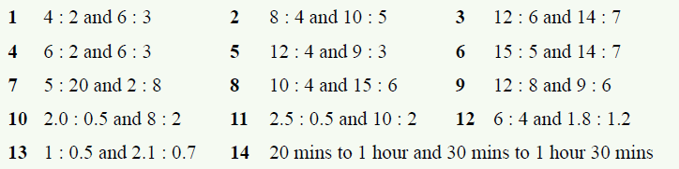
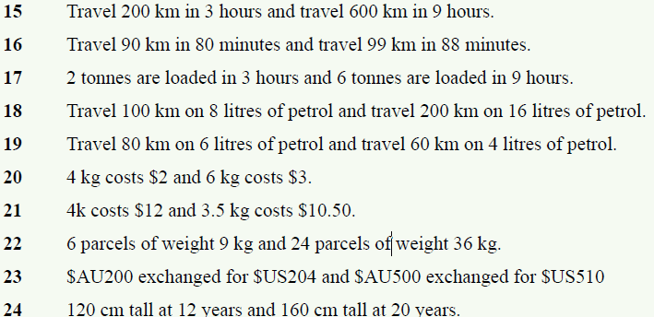
Complete Exercise 6.4 on page 76 to practice and Graph questions 1 to 9

Slide 15
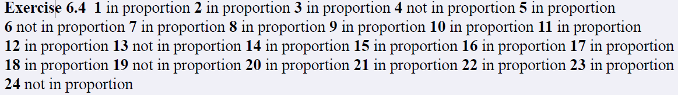
Answers to exercise 6.4

